Slide 1

Unit 2: Lesson 5
The Picture of Dorian Gray

Slide 2
Task 1: Read the first scene of Oscar Wilde’s famous novel The Picture of Dorian Gray and put the rest of the story in the correct order.
Task 2: Listen and cehck.
https://www.e-sfera.hr/dodatni-digitalni-sadrzaji/8bb3fe14-2ced-4620-ab6e-07a1fe121ec3/
Task 3: Read the story expressively.
5
3
2
4

Slide 3
Task 4: Read the text angain and write the names of the characters.
Lord Henry
Dorian
Sibyl
Basil
Dorian
Dorian

Slide 4
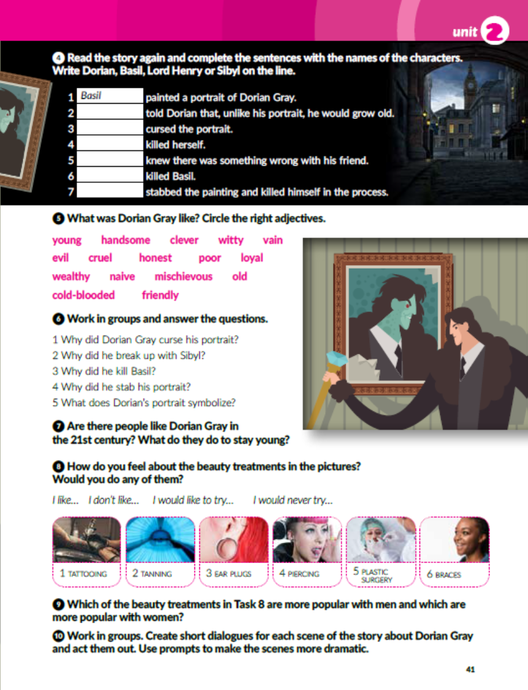

Task 5: What was Dorian Gray like? Circle.
vain – tašt
cruel – okrutan
loyal - odan
mischievous – nestašan
cold-blooded - hladnokrvan

Slide 5
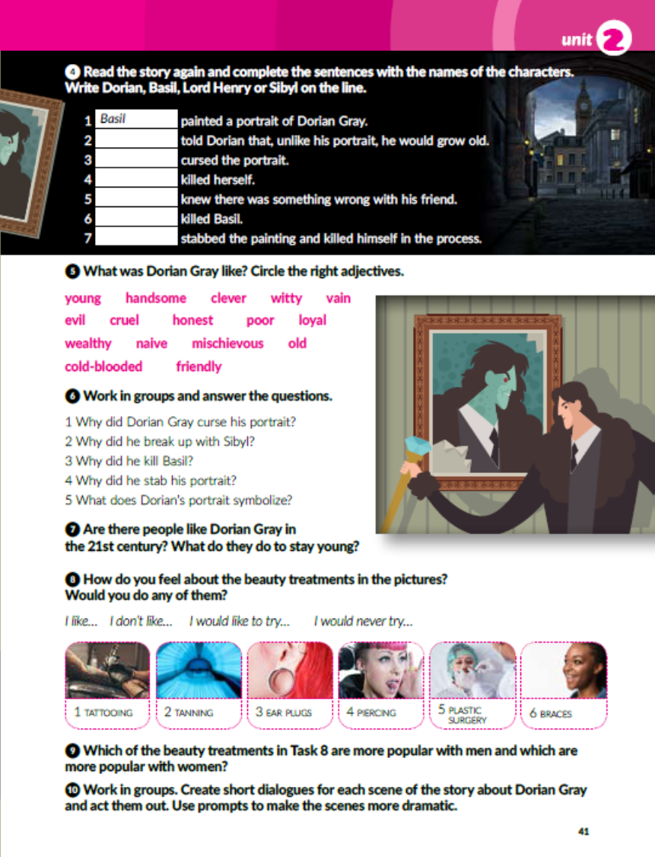

Slide 6

Think about the questions in task 7, 8 and 9 and answer them.

Slide 7
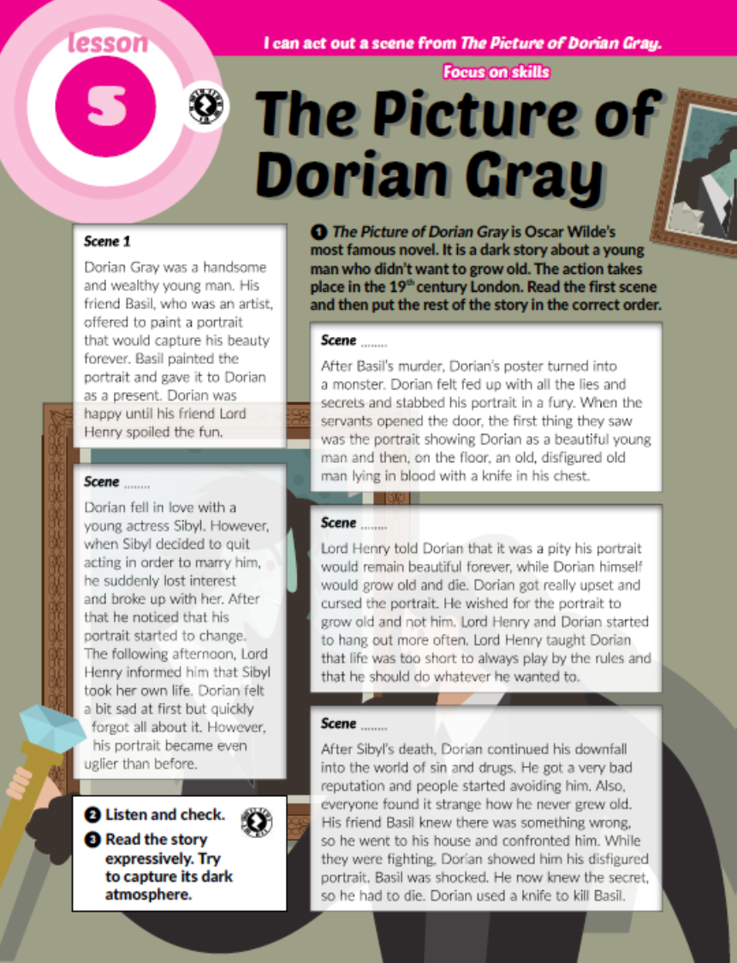
Task 10: Choose one of the scenes from the text and write a dialogue between the characters.
E.g:
Basil: Hi, Dorian!
Dorian: Hello, Basil!
Basil: Lovely weather today, isn’t it?
Dorian: Indeed. Have you finished my portrait?
I’ve been dying to see it.
Basil: Yes, it’s right here. I hope it captures
your beauty, my dear friend.
Dorian: I have no doubt in your talent.
(Dorian opens the parcel.)
Wow! It’s magnificent. I look amazing!
Thank you, my friend!
Basil: I’m so glad you like it.

Slide 8
workbook, page 39
Task 1: Complete the sentences.
vain
naive
cold-blooded
mischievous
handsome
cruel
honest

Slide 9
Task 2: Complete the book report.

Slide 10
Task 3: Draw a comic about the story of Dorian Gray.
You can change some elements or stick to the original.
Make sure the portrait changes in each scene.
Don’t forget to include the speech bubbles.

Slide 11

PLAY AND LEARN!
https://wordwall.net/play/18898/504/154

